Slide 1

OpenGL – Beginners Guide
From Basics to Intermediate

Slide 2
Introduction
Ranojay Sen

Slide 3
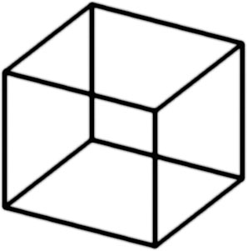
3D Graphics Overview
What actually is 3D Graphics ?
3D computer graphics are actually two-dimensional images on a flat computer screen that provide an illusion of depth, or a third dimension
Ranojay Sen

Slide 4
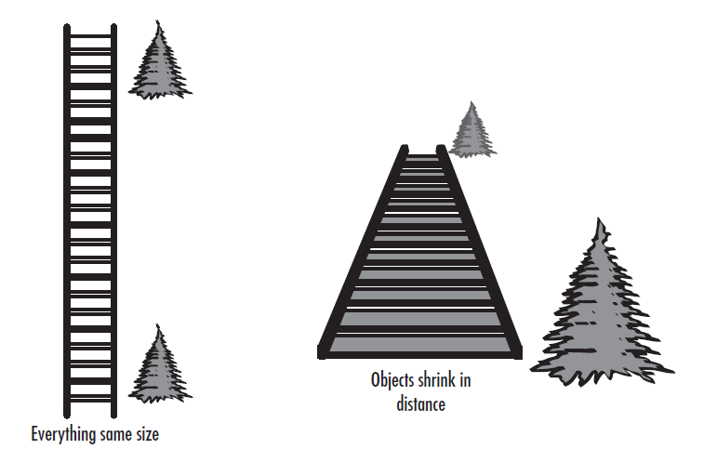
3D Graphics Overview
Perspective
Perspective refers to the angles between lines that lend the illusion of three dimensions
Ranojay Sen

Slide 5
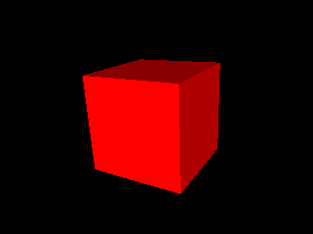
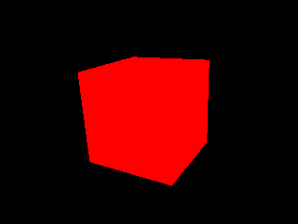
3D Graphics Overview
Light and Shading
Ranojay Sen

Slide 6
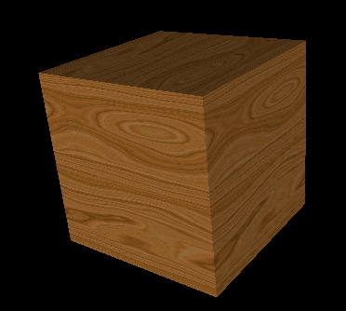
3D Graphics Overview
Texture
Ranojay Sen

Slide 7
Getting Started
Ranojay Sen

Slide 8
What is OpenGL ?
OpenGL is strictly defined as “a software interface to graphics hardware.” In essence, it is a 3D graphics and modeling library that is highly portable and very fast.
An API, Not a Language,It is more like the C runtime library
Initially developed by SGI as IRIS GL, later became an open standard and known as OpenGL
Ranojay Sen

Slide 9
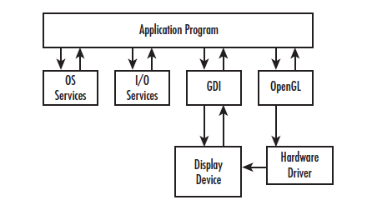
How Does OpenGL Work?
The Structure of OpenGL Program looks mostly like this
Ranojay Sen

Slide 10
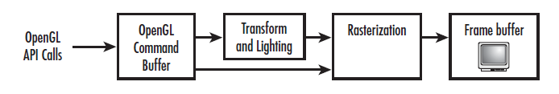
How Does OpenGL Work?
OpenGL Pipeline
The word pipeline is used to describe process that can take two or more distinct stages or steps.The figure shows a simplified version of the OpenGL pipeline.
Ranojay Sen

Slide 11
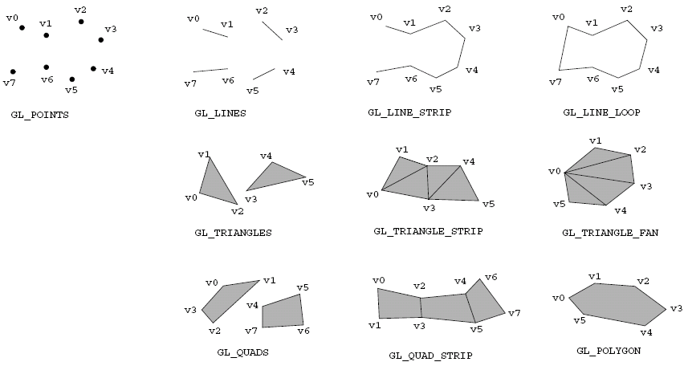
OpenGL Primitives
Ranojay Sen

Slide 12
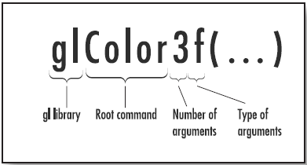
API Specifics
Header files
#include<windows.h>
#include<gl/gl.h>
#include<gl/glu.h>
Function-Naming Conventions
<Library prefix><Root command><Optional argument count><Optional argument type>
Ranojay Sen

Slide 13
OpenGL Extensions
OpenGL extensions are a means for OpenGL implementations to provide new or expanded functionality that the core of OpenGL does not provide
#include “glew.h”
Extension-Naming Conventions
  GL_EXT_blend_color
  glBlendColorExt
  GL_ARB_blend_color
  glBlendColorArb
Usage
const char *extensions = glGetString(GL_EXTENSIONS);
if ( strstr(extensions, “WGL_EXT_swap_control” != NULL) ){
wglSwapIntervalEXT =(PFNWGLSWAPINTERVALEXTPROC)wglGetProcAddress(“wglSwapIntervalEXT”);
if( wglSwapIntervalEXT != NULL )
WglSwapIntervalEXT(1);
}
Ranojay Sen

Slide 14
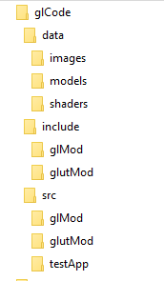
Source code distribution
Source file structure
Ranojay Sen

Slide 15

A small talk on CMake
What is CMake
CMake is an open-source, cross-platform family of tools designed to build, test and package software. CMake is used to control the software compilation process using simple platform and compiler independent configuration files, and generate native makefiles and workspaces that can be used in the compiler environment of your choice. The suite of CMake tools were created by Kitware in response to the need for a powerful, cross-platform build environment for open-source projects such as ITK and VTK.
https://cmake.org/
Ranojay Sen

Slide 16
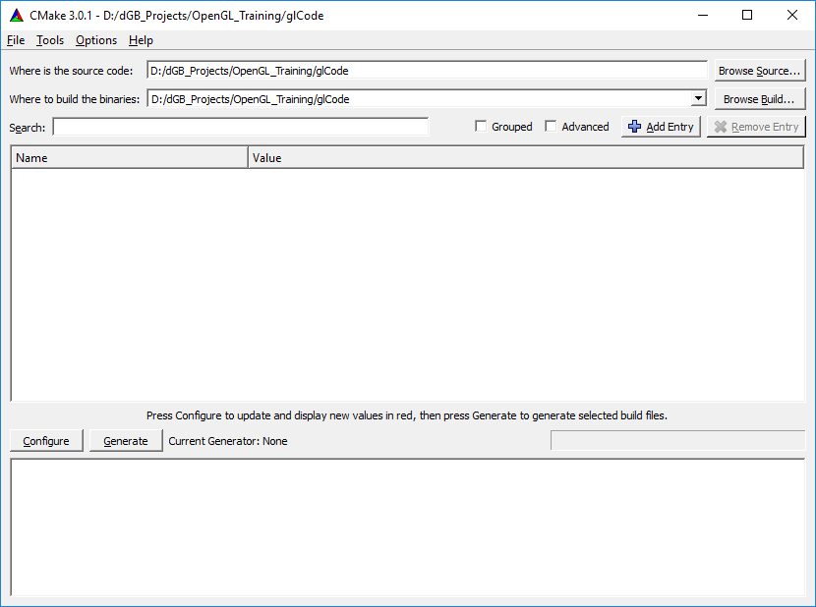
A small talk on CMake
Ranojay Sen

Slide 17
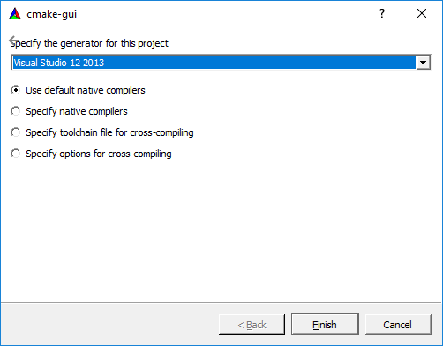
A small talk on CMake
Ranojay Sen

Slide 18
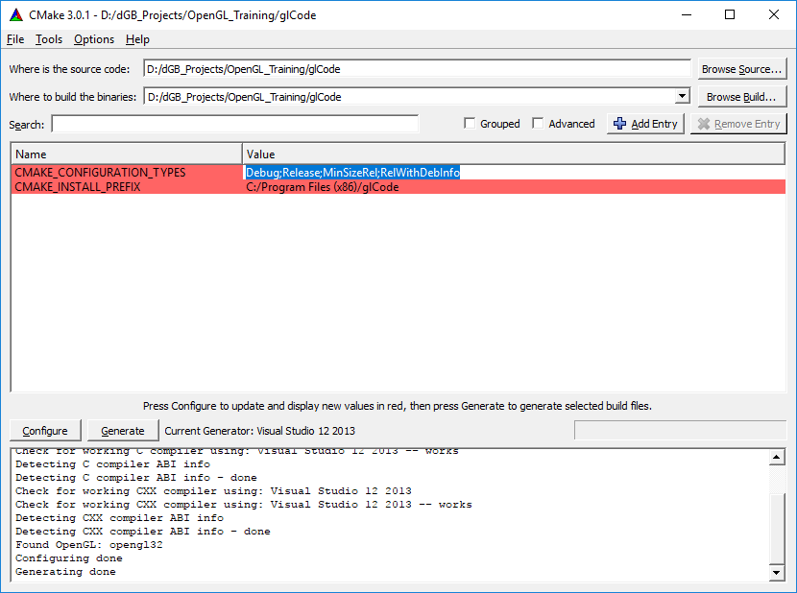
A small talk on CMake
Ranojay Sen

Slide 19
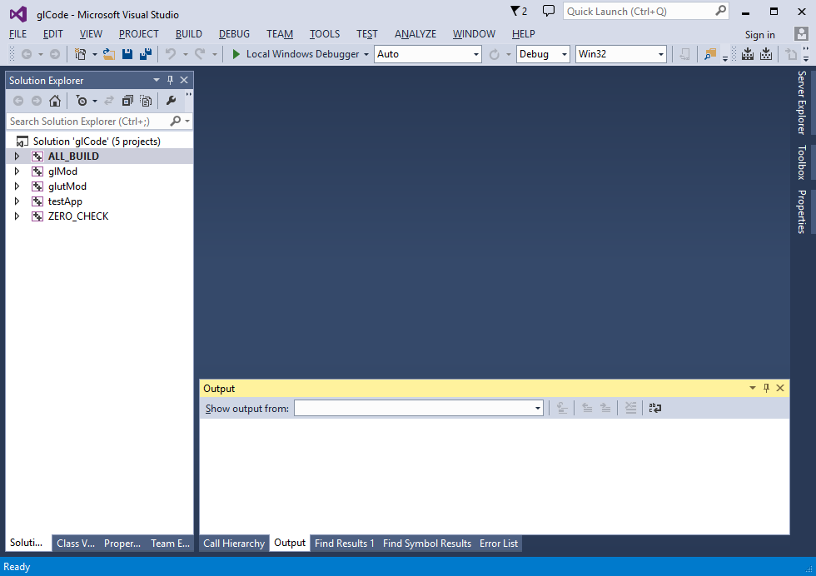
A small talk on CMake
Ranojay Sen

Slide 20
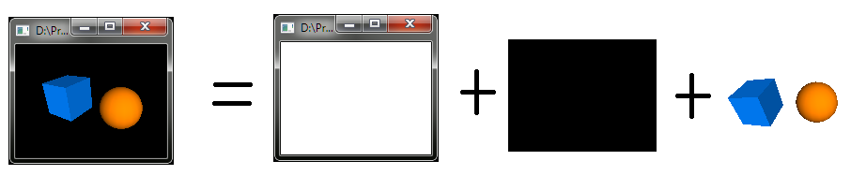
GLUT – What and How
What is GLUT
GLUT (pronounced like the glut in gluttony) is the OpenGL Utility Toolkit, a window system independent toolkit for writing OpenGL programs. It implements a simple windowing application programming interface (API) for OpenGL. GLUT makes it considerably easier to learn about and explore OpenGL programming. GLUT provides a portable API so you can write a single OpenGL program that works across all PC and workstation OS platforms.
Ranojay Sen

Slide 21
Drawing Shapes
Ranojay Sen

Slide 22
OpenGL State Machine
OpenGL is a state machine. You put it into various states (or modes) that then remain in effect until you change them
Saving and Restoring States
Values are correspondingly restored with this command:
    void glPushAttrib(GLbitfield mask);
    void glPopAttrib(GLbitfield mask);
glPushAttrib( GL_TEXTURE_BIT | GL_LIGHTING_BIT );
glEnable( GL_LIGHTING );
glDisable( GL_LIGHTING );
Ranojay Sen

Slide 23
Drawing Points, Lines, Triangles, Quads etc.
Drawing Examples ( Let's do hands on )
glClear( GL_COLOR_BUFFER_BIT | GL_DEPTH_BUFFER_BIT );
glDisable( GL_LIGHTING );
glPointSize( 5.0 );
glBegin( GL_POINTS );
glVertex3f( x1, y1, z1 );
glVertex3f( x2, y2, z2 );
glEnd();
Ranojay Sen

Slide 24
Drawing simple 3D Shapes
Drawing Cube ( With Code Example )
Drawing Sphere ( With Code Example )
Ranojay Sen

Slide 25
Drawing complex 3D Shapes
Drawing Complex Shapes ( With Code Example )
Ranojay Sen

Slide 26
Loading 3D Models
Loading .obj file ( With Code Example )
Ranojay Sen

Slide 27
Color, Material, Light and Normal
Ranojay Sen

Slide 28
Color, Material, Light and Normal
Color function basics
glColor3ub( 255, 0, 0 );
glColor3f( 1.0, 0, 0 );
Ranojay Sen

Slide 29
Color, Material, Light and Normal
Concept of Material
Matrerial determines how light will be reflected from the surface
  float diffuse_reflectivity[] = { 0.0, 0.25f, 0.25f, 1.0f };
float ambient_reflectivity[] = { 1.0, 1.0f, 1.0f, 1.0f };
glMaterialfv( GL_FRONT, GL_AMBIENT, ambient_reflectivity );
glMaterialfv( GL_FRONT, GL_DIFFUSE, diffuse_reflectivity );
Ranojay Sen

Slide 30
Color, Material, Light and Normal
Light – Ambient, Diffuse, Specular
Ambient light.
Ambient light means the light that is already present in a scene, before any additional lighting is added. It usually refers to natural light, either outdoors or coming through windows etc.
Diffuse light
The diffuse part of an OpenGL light is the directional component that appears to come from a particular direction and is reflected off a surface with an intensity proportional to the angle at which the light rays strike the surface
Specular light
Like diffuse light, specular light is a highly directional property, but it interacts more sharply with the surface and in a particular direction. A highly specular light (really amaterial property in the real world) tends to cause a bright spot on the surface it shineson, which is called the specular highlight
Ranojay Sen

Slide 31
Color, Material, Light and Normal
Blending
How the source and destination colors are combined when blending is enabled is controlled by the blending equation. By default, the blending equation looks like this
Cf = (Cs * S) + (Cd * D)
Here, Cf is the final computed color, Cs is the source color, Cd is the destination color, and S and D are the source and destination blending factors. These blending factors are set with the following function:
glBlendFunc(GLenum S, GLenum D);
Ranojay Sen

Slide 32
Color, Material, Light and Normal
RGBA, Transparency - Alpha blending
glBlendFunc(GL_SRC_ALPHA, GL_ONE_MINUS_SRC_ALPHA);
This function tells OpenGL to take the source (incoming) color and multiply the color (the RGB values) by the alpha value. Add this to the result of multiplying the destination color by one minus the alpha value from the source. Say, for example, that you have the color Red (1.0f, 0.0f, 0.0f, 0.0f) already in the color buffer. This is the destination color, or Cd. If something is drawn over this with the color blue and an alpha of 0.6 (0.0f, 0.0f, 1.0f, 0.6f), you would compute the final color as shown here:
Cd = destination color = (1.0f, 0.0f, 0.0f, 0.0f)
Cs = source color = (0.0f, 0.0f, 1.0f, 0.6f)
S = source alpha = 0.6
D = one minus source alpha = 1.0 – 0.6 = 0.4
Now, the equation
Cf = (Cs * S) + (Cd * D)
evaluates to
Cf = (Blue * 0.6) + (Red * 0.4)
Ranojay Sen

Slide 33
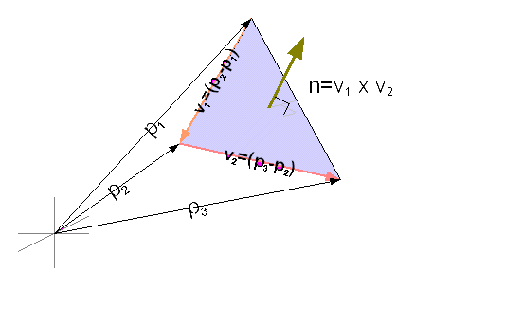
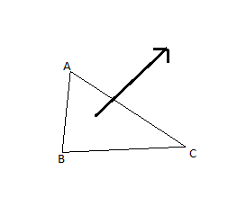
Color, Material, Light and Normal
Surface Normals
Ranojay Sen

Slide 34
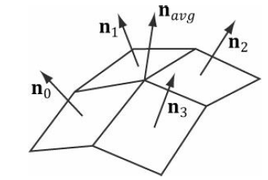
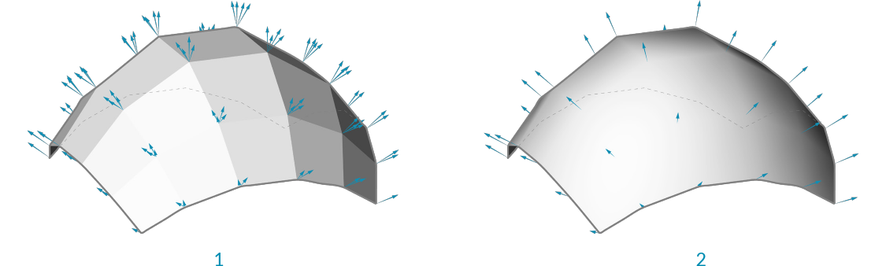
Color, Material, Light and Normal
Vertex Normals
Ranojay Sen

Slide 35
Texture Mapping
Ranojay Sen

Slide 36
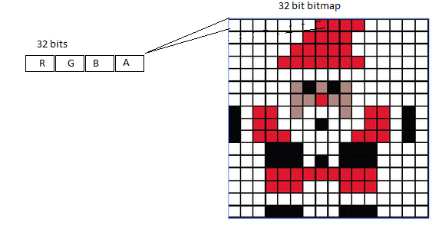
Texture Mapping
Bitmap images
Ranojay Sen

Slide 37
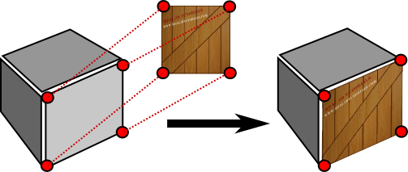
Texture Mapping
Texture mapping
The application of patterns or images to three-dimensional graphics to enhance the realism of their surfaces.
Ranojay Sen

Slide 38
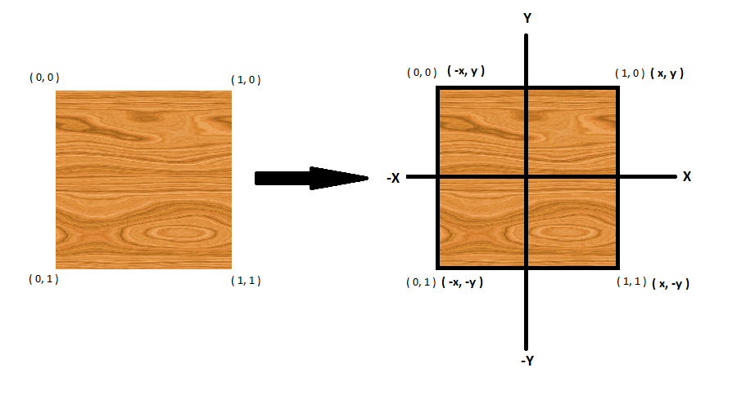
Texture Mapping
Texture Coordinates
Texture coordinates are specified as floating-point values that are in the range 0.0 to 1.0. Texturecoordinates are named s, t, r, and q (similar to vertex coordinates x, y, z,and w), supporting from one- to three-dimensional texture coordinates, and optionally a way to scale the coordinates.The application of patterns or images to three-dimensional graphics to enhance the realism of their surfaces.
Ranojay Sen

Slide 39
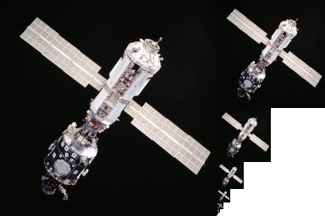
Texture Mapping
Mipmaps
In computer graphics, mipmaps (also MIP maps) or pyramids [1][2][3] are pre-calculated, optimized sequences of images, each of which is a progressively lower resolution representation of the same image. The height and width of each image, or level, in the mipmap is a power of two smaller than the previous level.
Ranojay Sen

Slide 40
Texture Mapping
Texture Environment
The process by which the final fragment color value is derived is called the texture environment function (glTexEnv()) Several methods exist for computing the final color, each capable of producing a particular effect. One of the most commonly used is the modulate function. For all practical purposes the modulate function multiplies or modulates the original fragment color with the texel color.
glTexEnvi( GL_TEXTURE_ENV, GL_TEXTURE_ENV_MODE, GL_MODULATE );
glTexEnvi( GL_TEXTURE_ENV, GL_TEXTURE_ENV_MODE, GL_REPLACE );
glTexEnvi( GL_TEXTURE_ENV, GL_TEXTURE_ENV_MODE, GL_BLEND );
Ranojay Sen

Slide 41
Texture Mapping
Texture Objects / Multiple Textures
Texture objects are an important new feature in release 1.1 of OpenGL. A texture object stores texture data and makes it readily available. You can now control many textures and go back to textures that have been previously loaded into your texture resources. Using texture objects is usually the fastest way to apply textures, resulting in big performance gains, because it is almost always much faster to bind (reuse) an existing texture object than it is to reload a texture image using glTexImage*D().
glGenTextures(GLsizei n, GLuint *textures);
glBindTexture(GLenum target, GLuint texture);
Ranojay Sen

Slide 42
Transformations Matrices et al.
Ranojay Sen

Slide 43
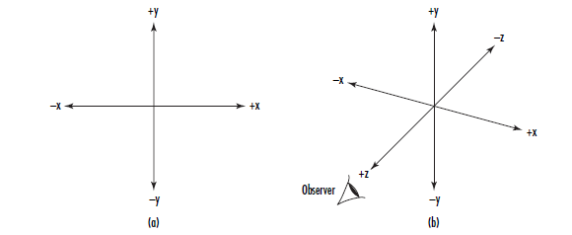
Transformations Matrices et al.
Eye Coordinates ( Viewing Transformations )
The viewing transformation is the first to be applied to your scene. It is used to determine the vantage point of the scene. By default, the point of observation in a perspective projection is at the origin (0,0,0) looking down the negative z-axis (“into” the monitor screen). This point of observation is moved relative to the eye coordinate system to provide a specific vantage point. When the point of observation is located at the origin, as in a perspective projection, objects drawn with positive z values are behind the observer.In an orthographic projection, however, the viewer is assumed to be infinitely far away on the positive Z axis, and can see everything within the viewing volume.
Ranojay Sen

Slide 44
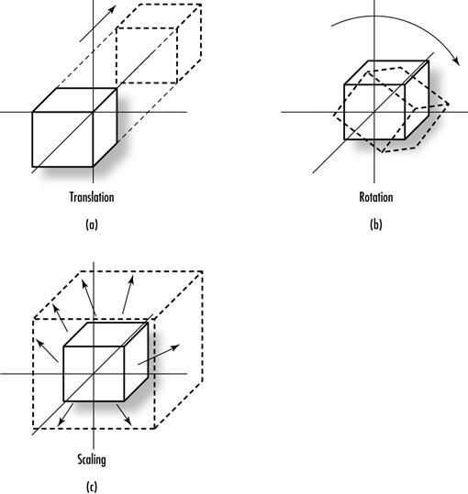
Transformations Matrices et al.
Modeling Transformation
Modeling transformations are used to manipulate your model and the particular objects within it. These transformations move objects into place, rotate them, and scale them
Ranojay Sen

Slide 45
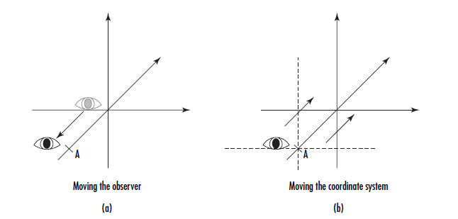
Transformations Matrices et al.
Modelview Duality
The viewing and modeling transformations are, in fact, the same in terms of their internal effects as well as their effects on the final appearance of the scene. The distinction between the two is made purely as a convenience for the programmer. There is no real difference visually between moving an object backward and moving the reference system forward
Ranojay Sen

Slide 46
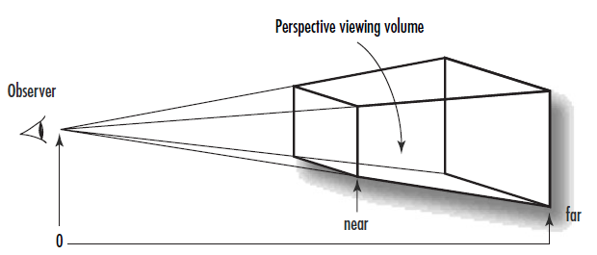
Transformations Matrices et al.
Projection Transformations
The projection transformation is applied to your vertices after the modelview transformation.This projection actually defines the viewing volume and establishes clipping planes.The clipping planes are plane equations in 3D space that OpenGL uses to determine whether geometry can be seen by the viewer
Orthographic: In an orthographic, or parallel, projection, all the polygons are drawn onscreen with exactly the relative dimensions specified. Lines and polygons are mapped directly to the 2D screen using parallel lines, which means no matter how far away something is, it is still drawn the same size, just flattened against the screen. This type of projection is typically used for rendering two-dimensional images such as blueprints or two-dimensional graphics such as text or onscreen menus.
Perspective: A perspective projection shows scenes more as they appear in real life instead of as a blueprint. The trademark of perspective projections is foreshortening, which makes distant objects appear smaller than nearby objects of the same size
Ranojay Sen

Slide 47
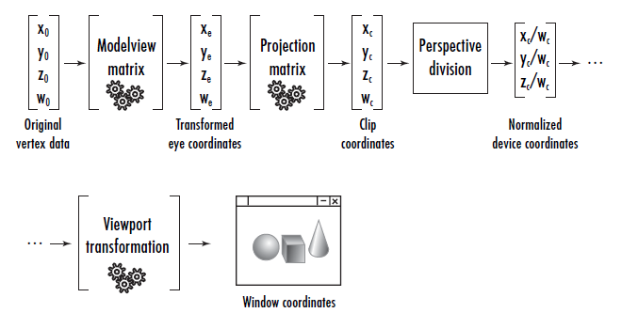
Transformations Matrices et al.
Viewport Transformations
When all is said and done, you end up with a two-dimensional projection of your scene that will be mapped to a window somewhere on your screen. This mapping to physical window coordinates is the last transformation that is done, and it is called the viewport transformation
Transformation Pipeline
Ranojay Sen

Slide 48
Transformations Matrices et al.
Basic Transformations => Translation, Scaling, Rotation
  Translation
    glTranslatef(GLfloat x, GLfloat y, GLfloat z);
  Scaling
      glScalef(GLfloat x, GLfloat y, GLfloat z);
  Rotation
      glRotatef(GLfloat angle, GLfloat x, GLfloat y, GLfloat z);
Ranojay Sen

Slide 49
Optimization Techniques
Ranojay Sen

Slide 50
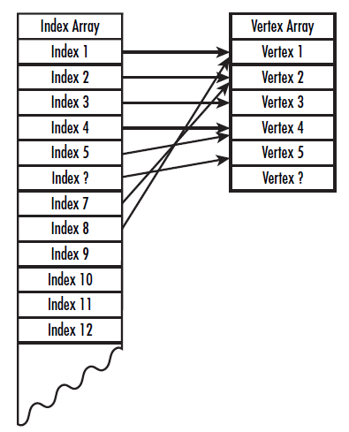
Optimization Techniques
Using Arrays and Indices
Ranojay Sen

Slide 51
Optimization Techniques
Revisit OpenGL Extensions
Will be using some extensions to use advanced techniques like VBO
#include "Gl/glew.h"
Ranojay Sen

Slide 52
Optimization Techniques
Using Vertex Buffer Objects (With code examples)
A Vertex Buffer Object (VBO) is an OpenGL feature that provides methods for uploading vertex data (position, normal vector, color, etc.) to the video device for non-immediate-mode rendering. VBOs offer substantial performance gains over immediate mode rendering primarily because the data resides in the video device memory rather than the system memory and so it can be rendered directly by the video device
Ranojay Sen

Slide 53
Advanced OpenGL – GLSL/Shaders
Ranojay Sen

Slide 54
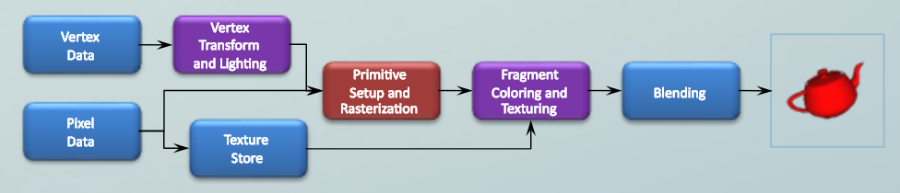
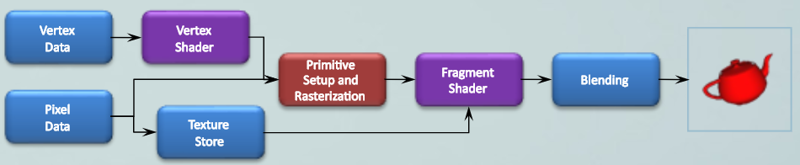
Advanced OpenGL
The Programmable Pipeline - Shaders
Ranojay Sen

Slide 55
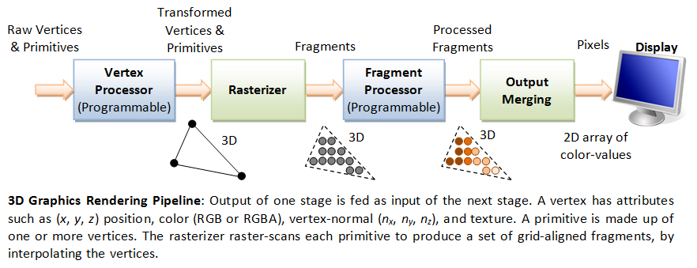
Advanced OpenGL
The Programmable Pipeline - Shaders
Ranojay Sen

Slide 56
Advanced OpenGL
OpenGL Shading Langauge – GLSL
Attributes − These variables hold the input values of the vertex shader program. Attributes point to the vertex buffer objects that contains per-vertex data. Each time the vertex shader is invoked, the attributes point to VBO of different vertices.
Uniforms − These variables hold the input data that is common for both vertex and fragment shaders, such as light position, texture coordinates, and color.
Varyings − These variables are used to pass the data from the vertex shader to the fragment shader.
Ranojay Sen

Slide 57
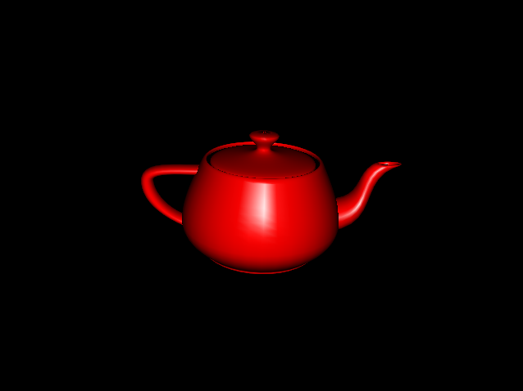
Advanced OpenGL
Vertex Shading – Simple Specular Lighting
Ranojay Sen

Slide 58
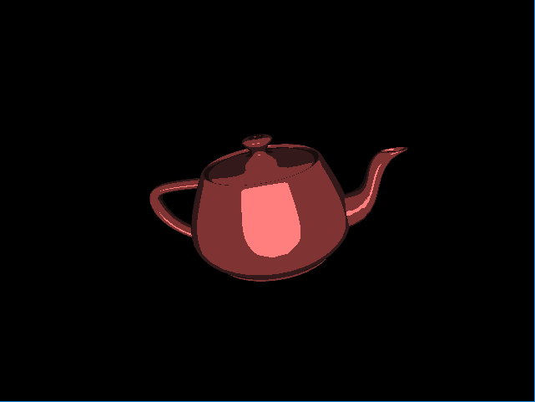
Advanced OpenGL
Fragment Shading – Toon Shading
Ranojay Sen

Slide 59
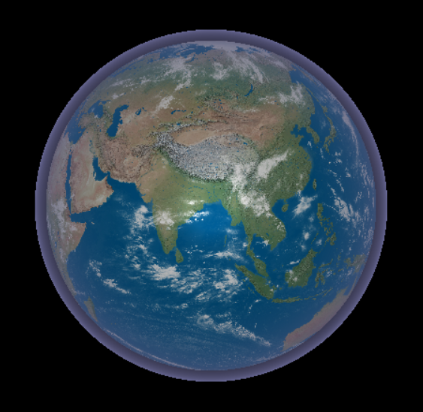
Advanced OpenGL
Realistic Visual Effects Shading – Earth with Atmosphere
Ranojay Sen

Slide 60
Acknowledgments
OpenGL Super Bible Fourth Edition
Wikipedia (www.wikipedia.org)
dGB Earth Sciences (www.dgbes.com)
Ranojay Sen

Slide 61
Thank You
Ranojay Sen

